Slide 1
CLASSIFICATION of A STUDENT’s FINAL grade Analytical CRM
Raghav Mehta
X17155151
Msc in data analytics
National college of ireland

Slide 2
RESEARCH ANALYSIS
Can we classify the students at risk in clearing a course from the given data ?
What are the relevant features required to classify the final grade outcome ?

Slide 3
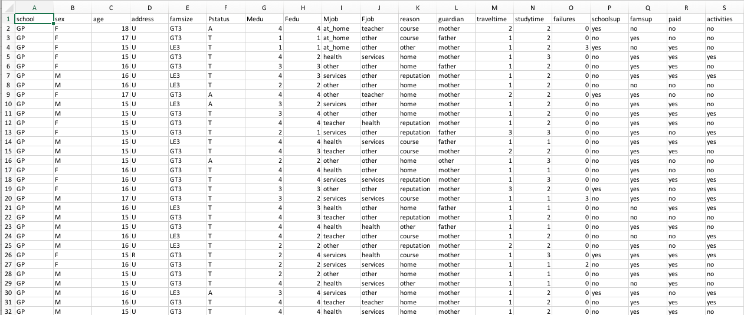
DATASET
Structured raw dataset available at UCI ML Repository (p=33, n=1044)
Portuguese school collated student reports and questionnaires
Convert dependent variable final grade G3 to categorical
Training and Testing ratio of 75:25

Slide 4
CORRELATION MATRIX for removing independent variables with high correlation

Slide 5
RANK OF IMPORTANT FEATURES

Slide 6
RECURSIVE FEATURE ELIMINATION
Building models using subsets of the dataset and identify those attributes that are and are not required to build an accurate model.

Slide 7
TECHNIQUE IMPLEMENTED – C5.0 DECISION TREE
Previous work done in neural networks, SVM and decision trees
However none of the work included feature selection and elimination
Due to small dataset and few numeric features, regression techniques cannot be applied
Decision tree is preferred when majority of features are categorical
Speed and memory efficient model

Slide 8
OVERVIEW OF MODEL PERFORMANCE

Slide 9
C5.0 MODEL – ALL FEATURES
Model accuracy is 83.14%
All 31 features are considered in the model (except the correlated variables)

Slide 10
C5.0 MODEL – removing feature g1
Model accuracy decreases marginally to 82.38%
This is because of the high collinearity between G1 and G2

Slide 11
C5.0 – only top 5 features
Model accuracy only decreased to 80.84% using only the top 5 relevant features
These are -
G2
Failures
Higher
Course
absences

Slide 12
BUSINESS SOLUTION
Provide the stakeholders with an integrated solution such as a learning management system to ensure coherent collection of data
The LMS will act as an early warning system for school management to take additive measures so that the at-risk students are able to cope up
Although student achievement is highly influenced by previous evaluations, certain features affect the direct outcome – the school can take action to lower failure rate
This will improve the quality of education imparted as well as help in resource management

Slide 13
FUTURE IMPROVEMENT SCOPE
Collecting data from numerous cohorts from multiple schools for a particular district, state and country
Broaden the dataset through questions that account for student psychological and social behavior
Applying Deep Learning models

Slide 14
THANK YOU

